Slide 1
Mortality Data Analyzer
A presentation for computer project
Pawan Ghimire-16
Pawan Poudel-17
Pradhumna Shrestha-18
School Of Mathematical Sciences
Balkhu, Kritipur
2082

Slide 2
Content
Introduction
Problem statement
Objectives
Scope and limitations
Implementation tools and technologies
Flowchart of the system
Conclusion
Screenshots of the system
References

Slide 3
Introduction
This project presents a Python-based actuarial analysis system developed to study mortality patterns using real-world patient data stored in an Excel dataset.
The objective of the project is to apply actuarial and statistical techniques to:
Estimate short-term mortality probabilities
Analyze seasonal mortality trends
Construct a simplified actuarial life table
Automate reporting and visualization

Slide 4
Problem Statement
We are given a dataset containing:
Patient ID
Age
Disease
Infection Month
Death Indicator
Years Until Death
We need to:
Determine short-term mortality probabilities for specific age groups and diseases.
Analyze whether mortality risk varies seasonally.
Construct a simplified life table from empirical data.
Automate reporting and visualization of results.

Slide 5
Objectives
Estimate Conditional Mortality Probability:
Calculate probability of death within 1, 2, and 3 years
Based on selected age band and disease
Support short-term risk assessment
Analyze Seasonal Mortality Trends:
Measure mortality rate by infection month
Identify possible seasonal patterns in death occurrence
Support epidemiological insights
Construct a Simplified Life Table:
Compute mortality rate (qx)
Estimate survivors (lx)
Estimate deaths (dx)
Simulate actuarial survival modeling
Automate Reporting and Visualization:
Export structured results to Excel
Generate graphical representations
Ensure professional and reusable output

Slide 6
Scope And Limitations
Scope of project:
Mortality Probability Estimation : Calculates conditional probability of death within 1, 2, and 3 years based on age band and disease.
Seasonal Mortality Analysis : Evaluates mortality rates by infection month to identify possible seasonal trends.
Life Table Construction : Builds a simplified actuarial life table including mortality rate (qx), survivors (lx), and deaths (dx).
Automated Data Processing : Reads Excel datasets, processes records efficiently, and organizes structured outputs.
Visualization and Reporting : Generates graphical outputs and exports results to Excel for professional presentation and analysis.

Slide 7
Limitations of the project:
Simplified Exposure Calculation : Uses number of records as exposure instead of full acturial person-years estimation.
Limited Time Horizon : Focuses only on 3-year mortality and does not model lifetime survival.
No Financial Modeling : Does not include discounting, present value, or premium calculation.
Dataset Dependency : Accuracy depends on the quality and size of the input dataset which is small.
No Advanced Statistical Models : Does not incorporate confidence intervals, regression models, or advanced survival analysis techniques.
Machine learning and AI models: Does not use any ML and AI models.

Slide 8
Implementation Tools and Technologies
Python : Core language for data processing, calculations, and automation.
openpyxl : Handles Excel file reading and writing.
Matplotlib : Creates visualizations and graphs for analysis.
Object-Oriented Programming (OOP) : Ensures modular and scalable code structure.
Excel Dataset (.xlsx) ; Provides structured patient mortality data for analysis.

Slide 9
Flowchart
Startt
Age Band
Data Loading/Import
Print error
Death probability
1-3 yrs
Load Excel : Read and store
Analysis
Inputs: Age and disease
Life table (qx,lx,dx)
And graphs
Yes
In Dataset?
No
Endt

Slide 10
Conclusion
This project successfully demonstrates the practical implementation of actuarial mortality analysis using Python. By transforming raw patient data into structured actuarial metrics, the system effectively calculates conditional 3-year death probabilities, analyzes seasonal mortality trends, and constructs a simplified life table. The use of Object-Oriented Programming ensures modularity, clarity, and scalability of the system. Automated Excel reporting and graphical visualization further enhance the usability and professional presentation of results. Although the model uses simplified assumptions, it provides a strong foundation for actuarial risk modeling and can be extended to include advanced statistical techniques, financial modeling, and long-term survival analysis. Overall, this project bridges theoretical actuarial concepts with real-world data processing, demonstrating how computational tools can support mortality risk assessment and insurance-related analysis.

Slide 11
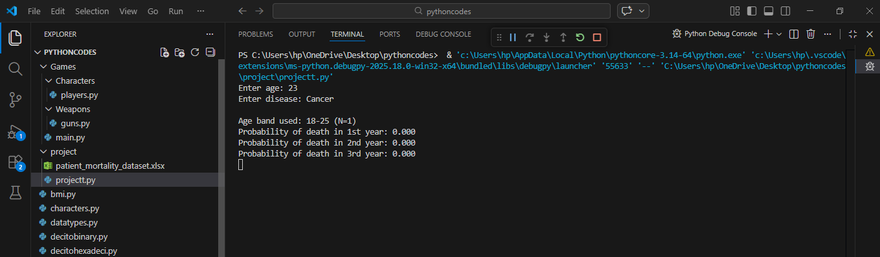
Screenshots Of The System

Slide 12
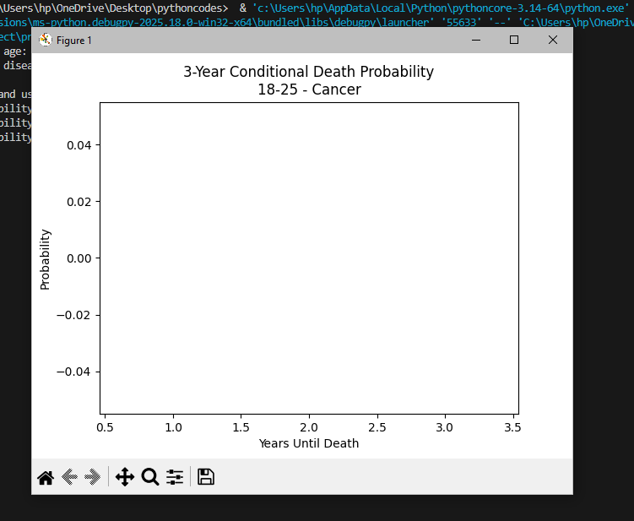

Slide 13
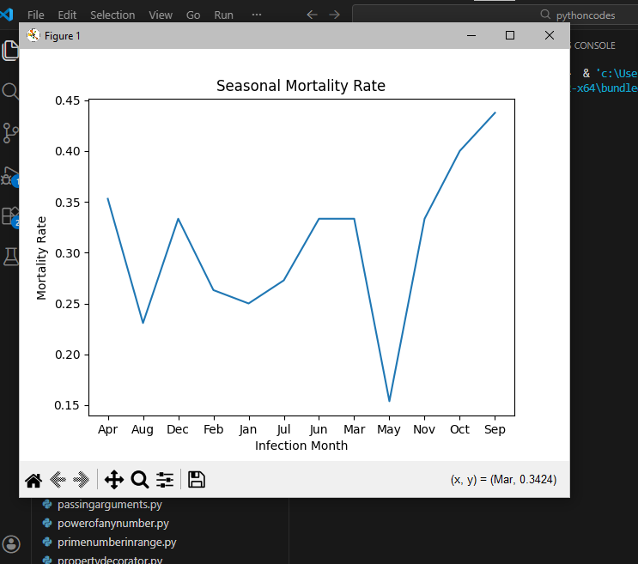

Slide 14
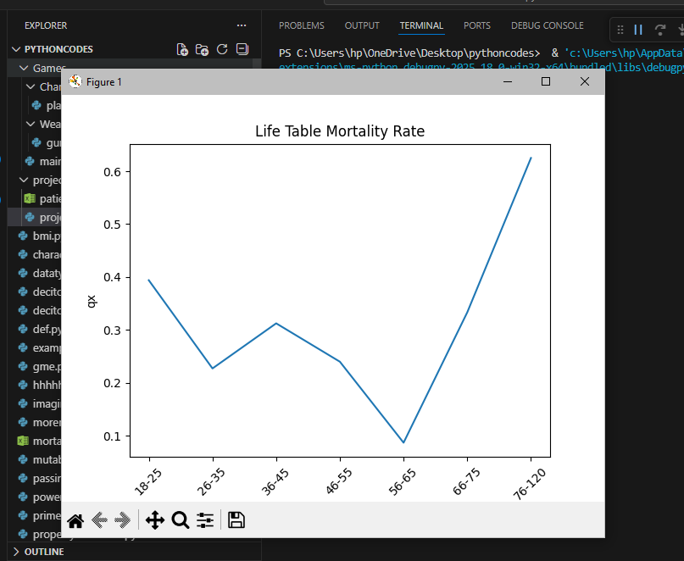

Slide 15
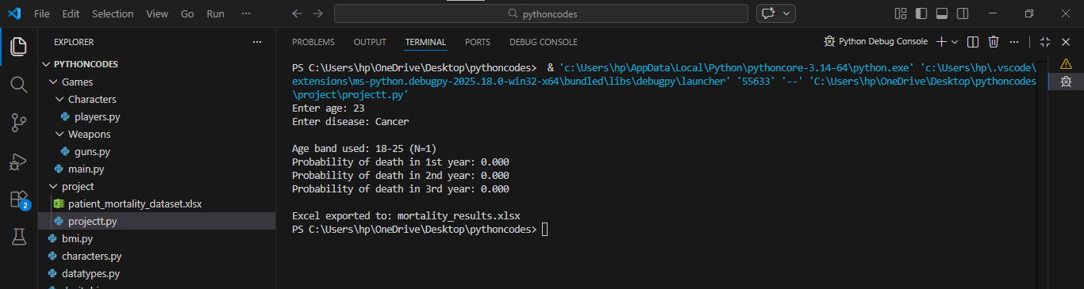

Slide 16
References
https://chatgpt.com/
https://scholar.google.com/
https://www.deepseek.com/
https://www.wikipedia.org/

Slide 17
THANK YOU

